Slide 1
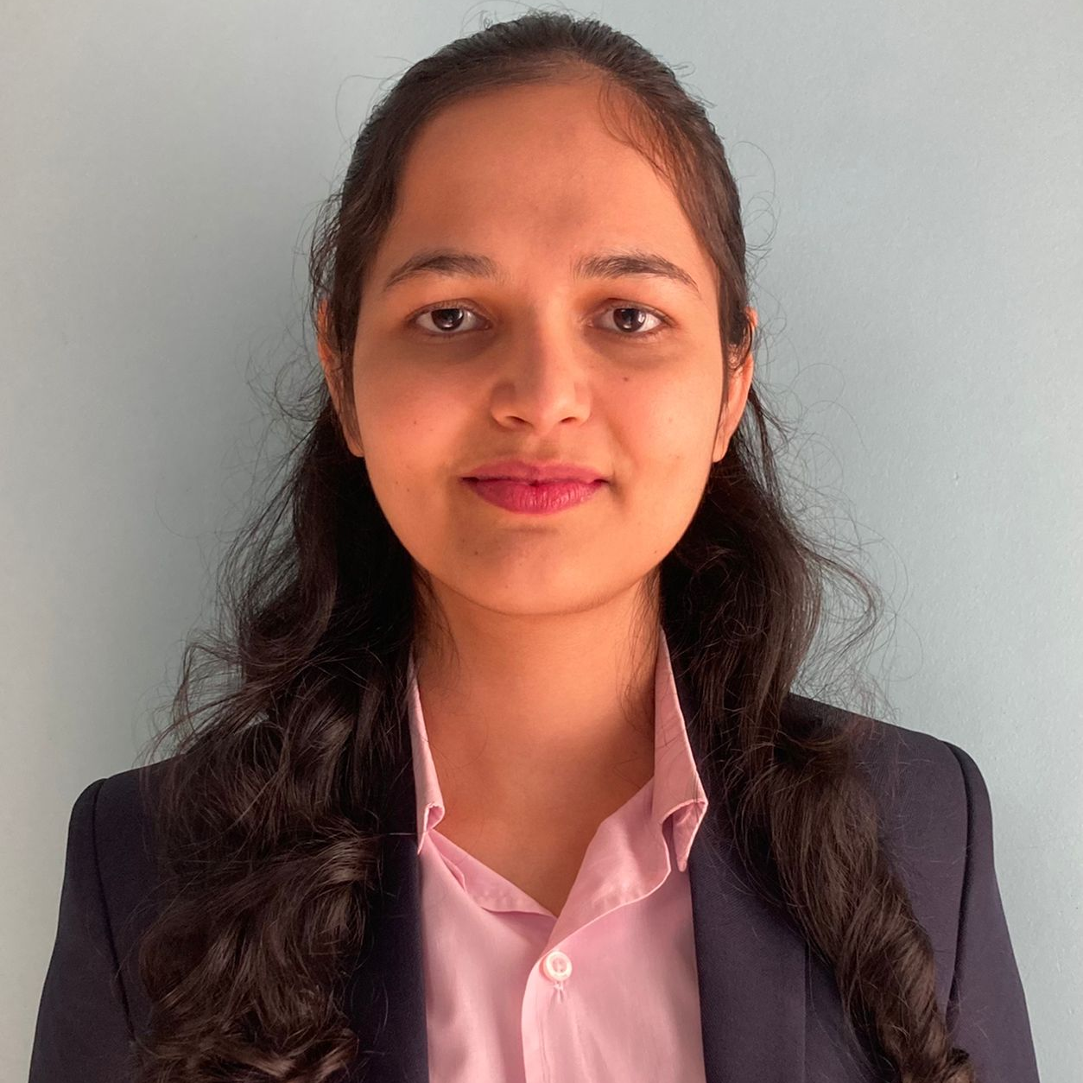



Prajakta Jarad
Analyst/Software Engineer
Bachelor of Engineering(BE) in Computer Science : 2018 - 2022
Skills
Java 8 /J2EE | Java Basics, OOPS, Collections, Arrays, Loops, Lambda Expressions
Spring core | Dependency Injection, Autowire
Spring REST | REST controllers, Implementation of GET, POST, PUT & DELETE, Bean Validation & Exception Handling, Controller & Repository layer
Spring Data JPA | Implement DAO layer using spring Data repositories
Spring Boot Microservices | Spring Boot Starters, annotations, Messaging Service using RabbitMq,Swagger API documents
Spring Cloud | Eureka, Spring Cloud API Gateway
Database | MySql, MongoDB
UI Tech | HTML 5 & CSS 3,JavaScript,Bootstrap, Angular
Tools | Git, Postman, IDE
Add On skills | Time management, Patience
Mumbai
prajakta-gorakh.jarad@capgemini.com
+91 9067420004
A4
Full Stack Developer
Hands on experience in creating microservices with Spring Boot, Spring Security, Spring Cloud API Gateway, Eureka server
Proficient in creating Single page Web Application in angular
Experience in creating documentation with swagger and in unit testing using Junit, Mockito, in messaging service using RabbitMQ, in email service
Online Hotel Management System
Completed end to end case study of Online Hotel Management System along with Swagger and payment implementation using Razorpay gateway, UI with Angular used for user interface.
Hospital Management System
Developed Hospital Management System using Spring Boot, MySql and testing all api through postman
Check out my work on GitHub & Video Profile

